Slide 1
Strength of Intermolecular Forces
Lesson Objectives:
Describe and explain the origin and relative strength of the following intermolecular interactions for molecules of a similar size:
dispersion forces
dipole-dipole attractions
hydrogen bonds
Explain the relationships between physical properties such as melting and boiling point, and the types of intermolecular forces present in substances of similar size

Slide 2
Starter
DEMO:
Place a small drop of alcohol on the back of your left hand.
Place a different alcohol on the other hand.
Take note of your observation.

Slide 3
Strength from highest to lowest
Highest strength
Lowest strength
Hydrogen Bonds (strongest dipole-dipole)
Dipole-dipole interactions
Induced dipole interactions
Dispersion forces
Highest melting/boiling points
Lowest melting/boiling points
Why?
Because it takes more energy to separate the forces!

Slide 4
Why is water a liquid?

Slide 5
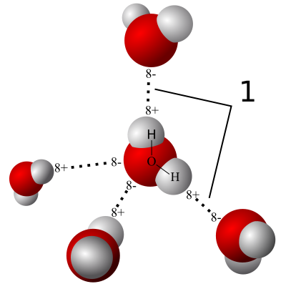
What is a Hydrogen Bond?
Just like in other polar molecules this hydrogen “bond” isn't actually a bond at all. It is a force that attracts molecules together. Specifically involving hydrogen which is attracted to the high electron density in lone pairs of electrons on other highly electronegative elements.

Slide 6
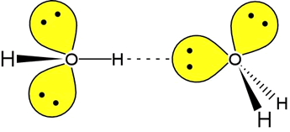
What is a Hydrogen Bond?
You will only find hydrogen bonds:
With polar molecules
With molecules containing hydrogen
With molecules that have oxygen (most common), nitrogen and fluorine. Other elements form the same “bond” but to a lesser extent (so we don’t call it hydrogen bonding we call it dipole-dipole)
Between molecules
Lone pairs (non-bonded pairs) of electrons

Slide 7
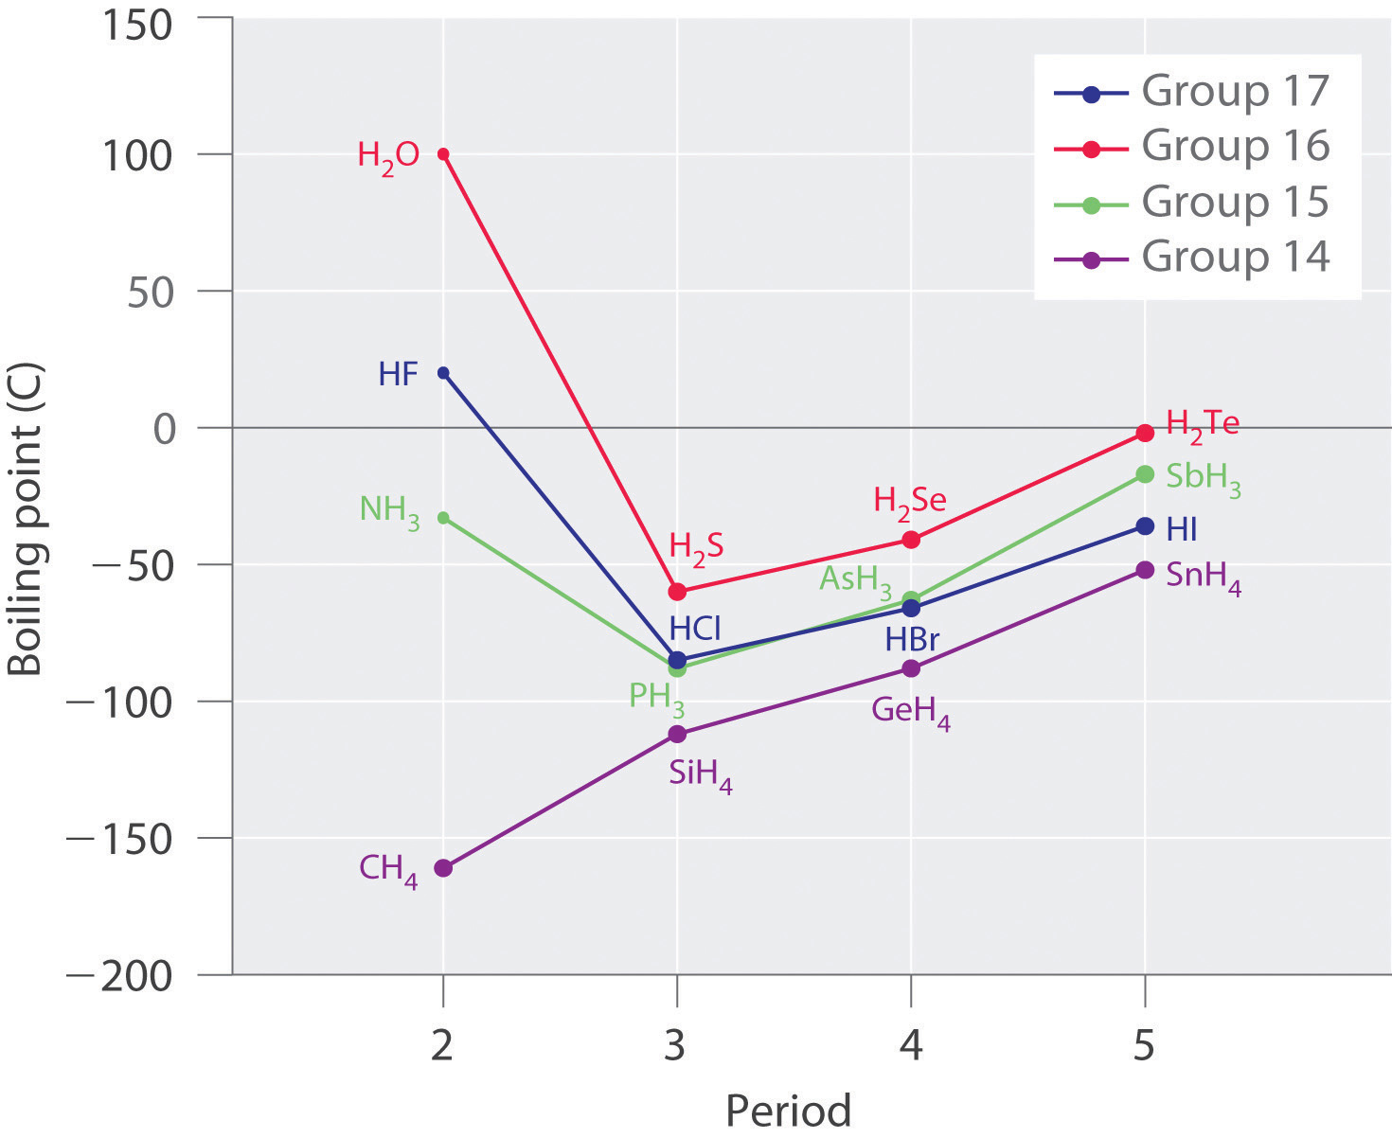
Boiling points of molecules with hydrogen
The Effects of Hydrogen Bonding on Boiling Points. These plots of the boiling points of the covalent hydrides of the elements of groups 14–17 show that the boiling points of the lightest members of each series for which hydrogen bonding is possible (HF, NH₃, and H₂O) are anomalously high for compounds with such low molecular masses.

Slide 8
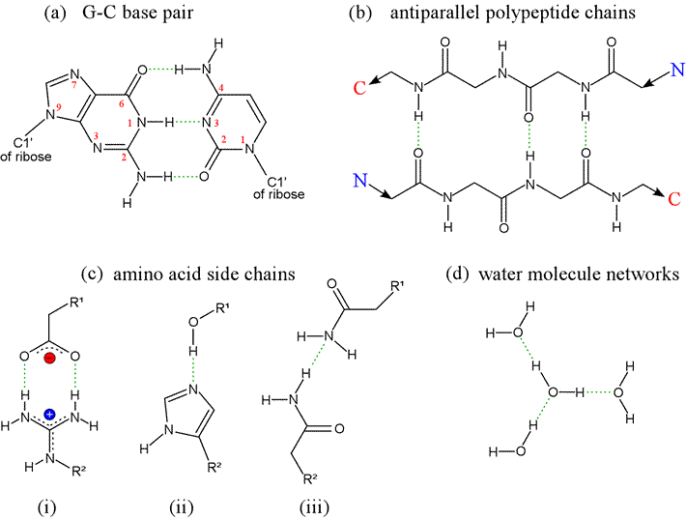
Examples of Hydrogen bonds
Hydrogen bonds can vary in strength from very weak (1–2 kJ mol⁻¹) to extremely strong (161.5 kJ mol⁻¹ in the ion HF₂⁻ )Typical enthalpies in vapor include:
F−H…:F (161.5 kJ/mol)
O−H…:N (29 kJ/mol)
O−H…:O (21 kJ/mol)
N−H…:N (13 kJ/mol)
N−H…:O (8 kJ/mol)
BUT WE DON’T NEED TO KNOW THESE VALUES

Slide 9
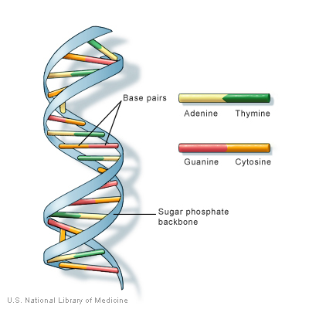
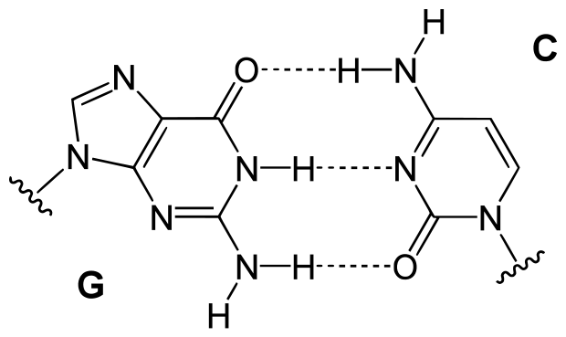
DNA
Hydrogen bonding also plays an important role in determining the three-dimensional structures adopted by proteins and nucleic bases. In these macromolecules, bonding between parts of the same macromolecule cause it to fold into a specific shape, which helps determine the molecule's physiological or biochemical role.
Hydrogen Bonding between Guanine and Cytosine

Slide 10
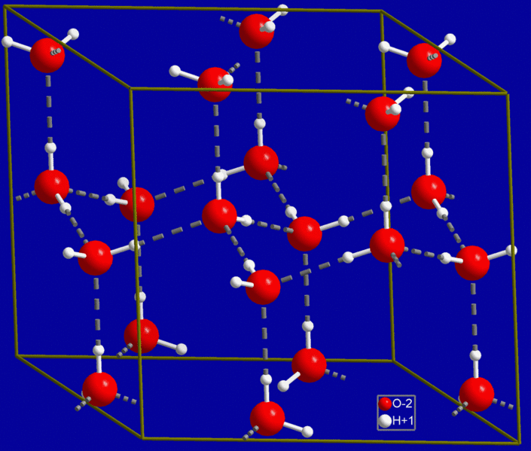
Why is ice less dense than water?
If you look at this small cube you can see how aligned these molecules are with one another.
They are in a 3D hexagonal shape and are spaced out very evenly.
In liquid water these molecules are more closely packed in. This is why your ice cubes float in your drink!

Slide 11
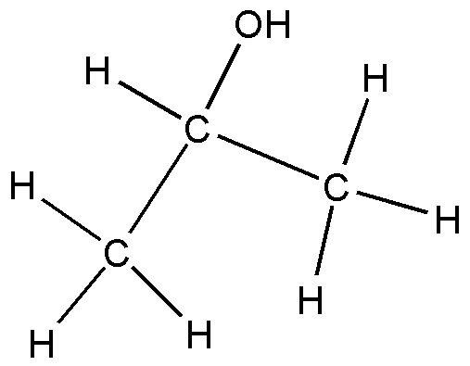
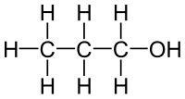
Isomers
Same chemical formulae for a molecule just a different shape. Eg.
C₃H₆O can be written
CH₃CH₂CH₂OH OR CH₃CHOHCH₃

Slide 12
Size of molecules
The larger a molecule is the more mass it has.
The more mass a molecule has the more energy it requires to move.
Not only this but the bigger the molecule is the larger the electron cloud it has.
More points of contact between these electron clouds increases the amount of dispersion forces.
The more dispersion forces it attains the more energy it will take to separate these molecules and thus a higher melting and boiling point is attained.

Slide 13
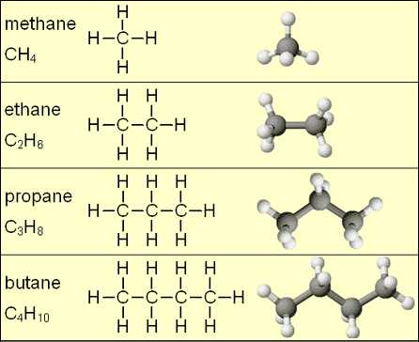
Large vs. small
Really low
Melting &
boiling point
Higher
Melting &
boiling point

Slide 14
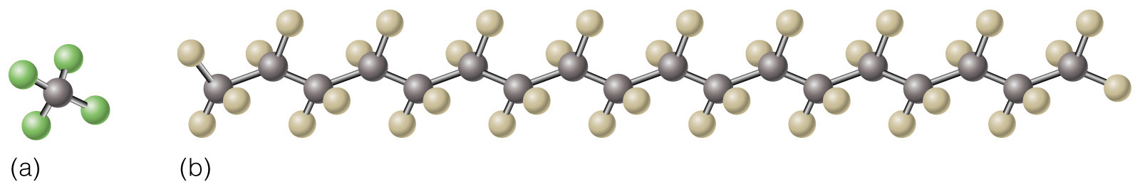
Which molecule will produce a more viscous liquid state?
Definition:
Surface tension
Viscosity

Slide 15
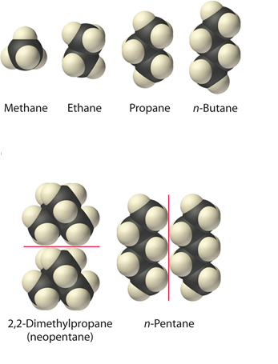
Question:
Arrange neopentane, pentane, butane, propane, ethane, methane in order of increasing boiling points
Hint:
Determine the intermolecular forces in the compounds and then arrange the compounds according to the strength of those forces. The substance with the weakest forces will have the lowest boiling point.

Slide 16
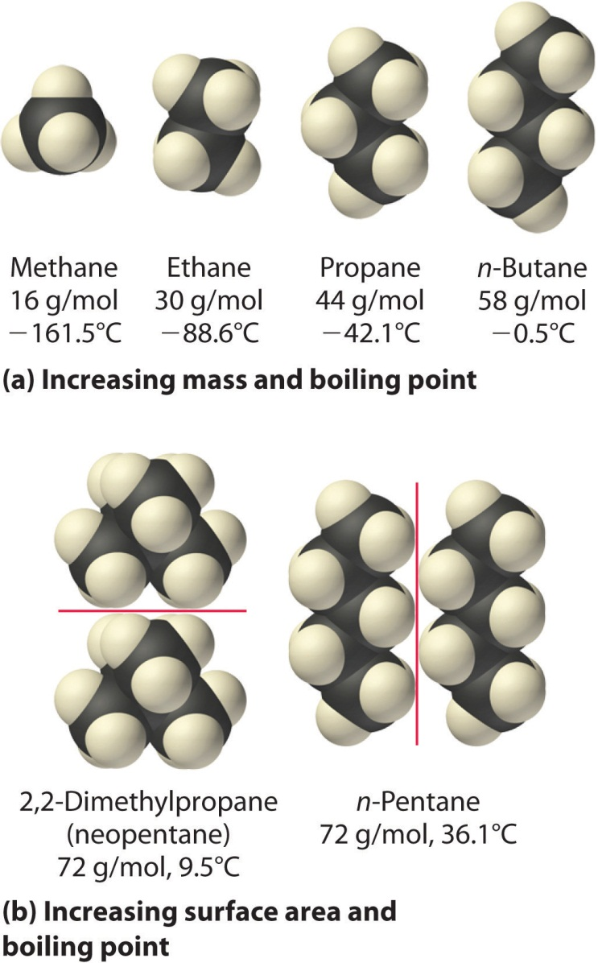
Solution
The six compounds are alkanes and nonpolar, so London dispersion forces are the only important intermolecular forces. These forces are generally stronger with increasing molecular mass, so methane should have the lowest boiling point and pentane should have the highest, with the pentane isomer falling in between.

Slide 17
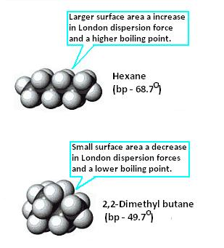
Same size; Two isomers C₆H₁₄
When the shape is changed it changes the amount of overlap between the electron clouds.

Slide 18
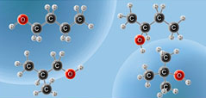
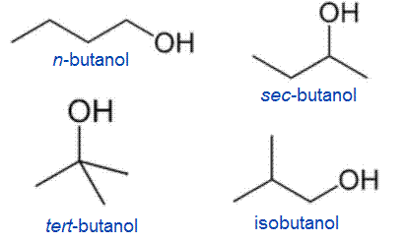
Same effect on polar molecules
The position of the -OH group effects the ability to create hydrogen bonds.

Slide 19
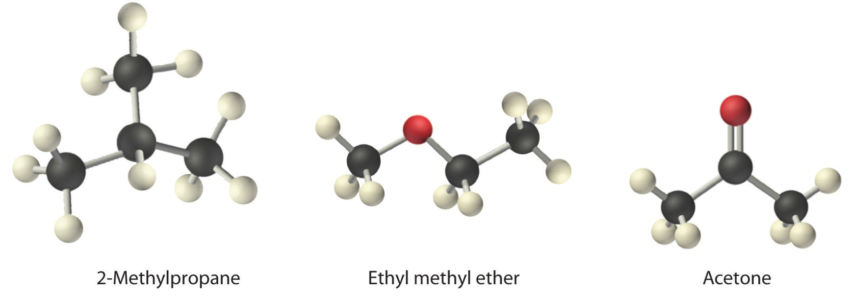
Question:
Arrange ethyl methyl ether (CH₃OCH₂CH₃), 2-methylpropane [isobutane, (CH₃)₂CHCH₃], and acetone (CH₃COCH₃) in order of increasing boiling points. Their structures are as follows:
Hint:
Compare the molar masses and the polarities of the compounds. Compounds with higher molar masses and that are polar will have the highest boiling points.

Slide 20
Solution
The three compounds have essentially the same molar mass (58–60 g/mol), so we must look at differences in polarity to predict the strength of the intermolecular dipole–dipole interactions and thus the boiling points of the compounds. The first compound, 2-methylpropane, contains only C–H bonds, which are not very polar because C and H have similar electronegativities. It should therefore have a very small (but nonzero) dipole moment and a very low boiling point. Ethyl methyl ether has a structure similar to H₂O; it contains two polar C–O single bonds oriented at about a 109° angle to each other, in addition to relatively nonpolar C–H bonds. As a result, the C–O bond dipoles partially reinforce one another and generate a significant dipole moment that should give a moderately high boiling point. Acetone contains a polar C=O double bond oriented at about 120° to two methyl groups with nonpolar C–H bonds. The C–O bond dipole therefore corresponds to the molecular dipole, which should result in both a rather large dipole moment and a high boiling point. Thus we predict the following order of boiling points: 2-methylpropane < ethyl methyl ether < acetone. This result is in good agreement with the actual data: 2-methylpropane, boiling point = −11.7°C, and the dipole moment (μ) = 0.13 D; methyl ethyl ether, boiling point = 7.4°C and μ = 1.17 D; acetone, boiling point = 56.1°C and μ = 2.88 D.

